Slide 1
Project 1: Group 12
Project Team:
Caleb Meinke, Luisa Murillo,
Gavin Bozan, and Charles Arnold

Slide 2
Project: Dataset | Introduction & Inspiration
Dataset:
Financial Transactions Dataset: Analytics
https://www.kaggle.com/datasets/computingvictor/transactions-fraud-datasets/code
Introduction:
The “Financial Transactions Dataset: Analytics,” contains financial payment card and card holder demographic information from 2010 through 2019.
Notes:
Talking points:

Slide 3
Objectives
Explore financial health on how it varies with:
Demographics
Individual financial attributes,
Geographic regions
Analyze the correlations between the above characteristics and established measurement of financial health, know as the debt-to-income (DTI) ratio

Slide 4
Customer Demographics
QUESTION 1: How do customer demographics (e.g., age, gender, income) correlate with customer financial health

Slide 5


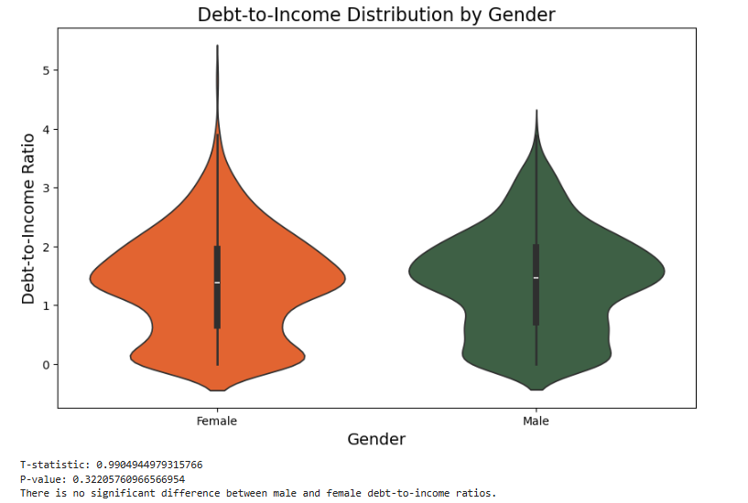
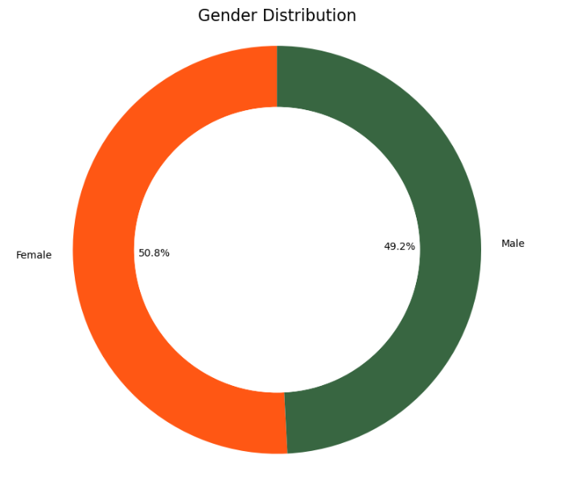


Slide 6
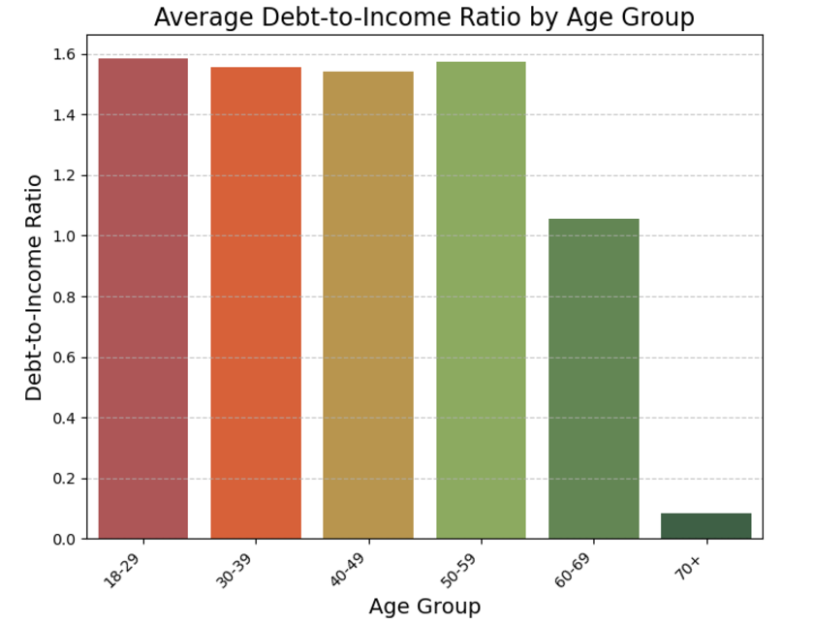

Slide 7
Financial Attributes
QUESTION 2: How do financial attributes (e.g., card type, loan amount, credit score, total debt) correlate with customer financial health?

Slide 8
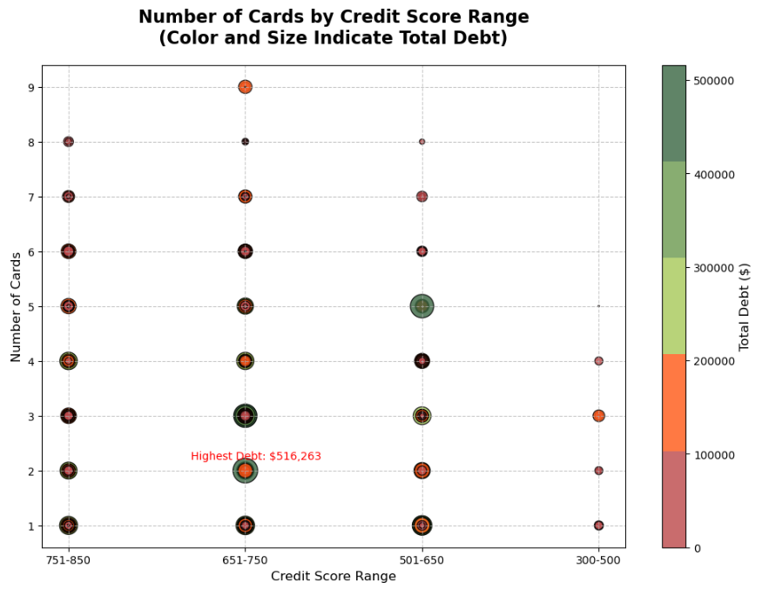

Slide 9
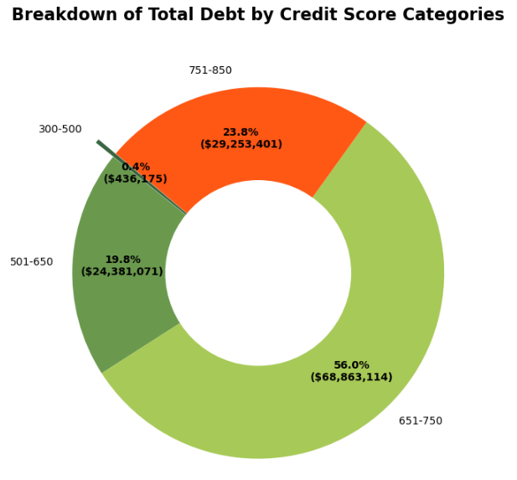
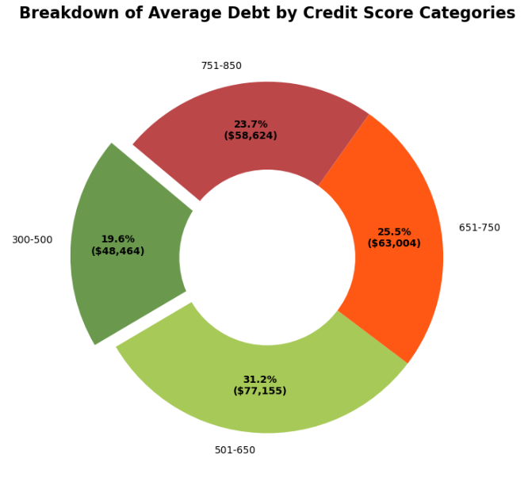

Slide 10
Geographic Information
QUESTION 3: How does customer geographic information (e.g. state, city, per capita income) correlate with customer financial health?

Slide 11
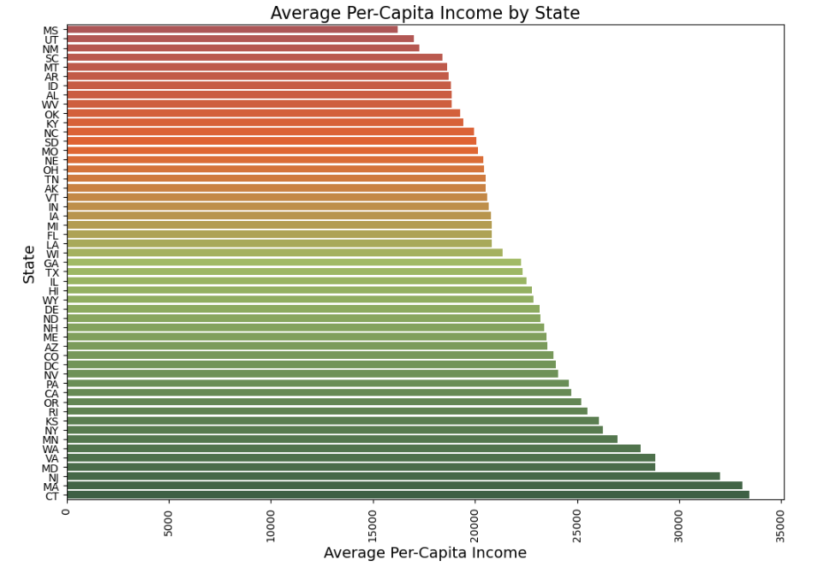

Slide 12
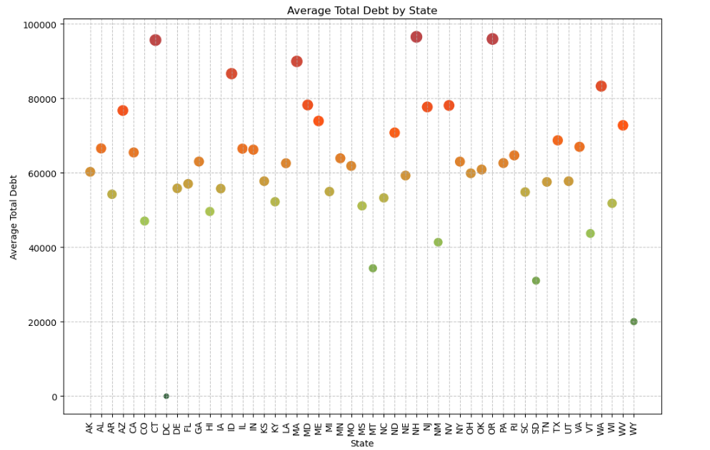

Slide 13
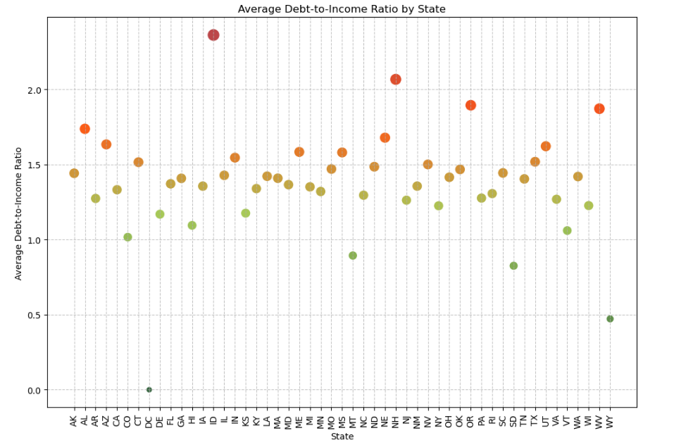

Slide 14
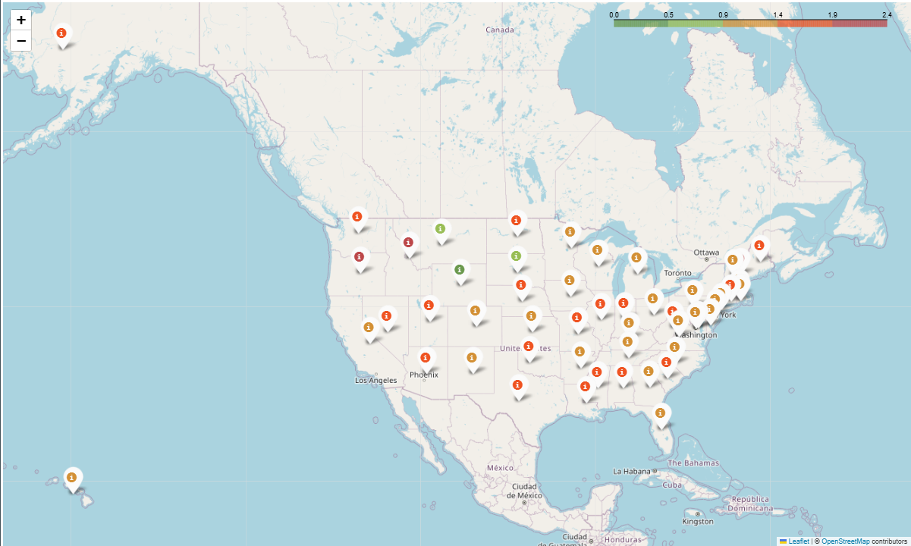
Average Debt-to-Income (DTI) by State

Slide 15
Bias and Limitations
Limitations:
Fictitious data – Use for exercise
Some states had very small sample size
Bias:
Distribution of Male(49.2%)to Female (50.8%)
Wasn’t a 50/50 split but is Reflective of US Population
# of outliers impacted ‘gold standard of measurement’ (e.g. Age, State, DTI Ratio)
Removed outliers in total debt and yearly income to ensure that the DTI was smoothed out
May have unintentionally created bias by being selective of the outliers we removed

Slide 16
Regression Analysis

Slide 17
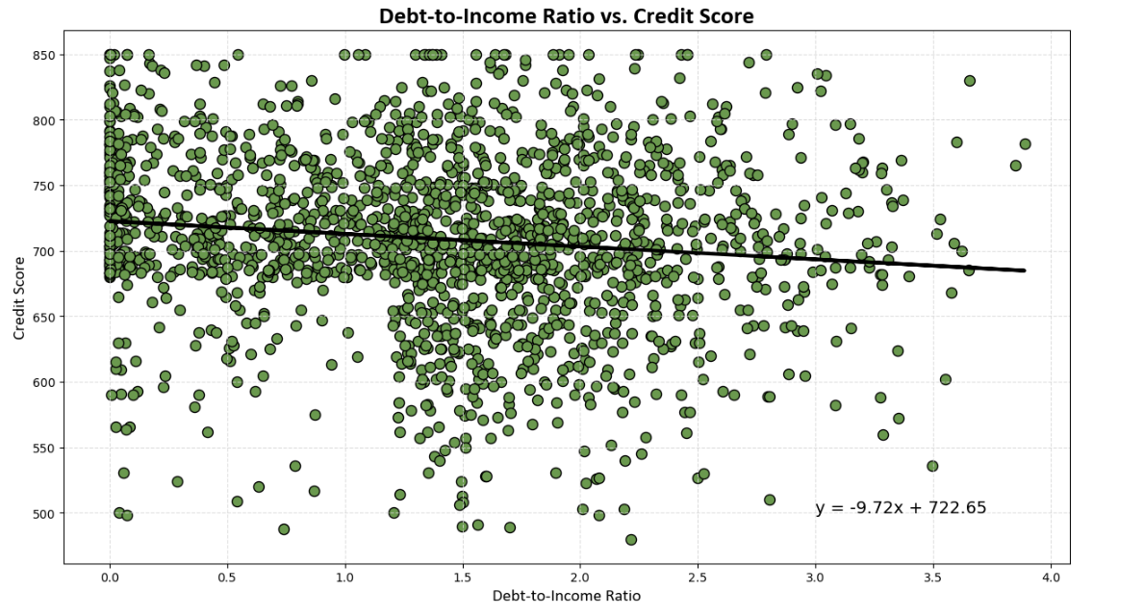

Slide 18
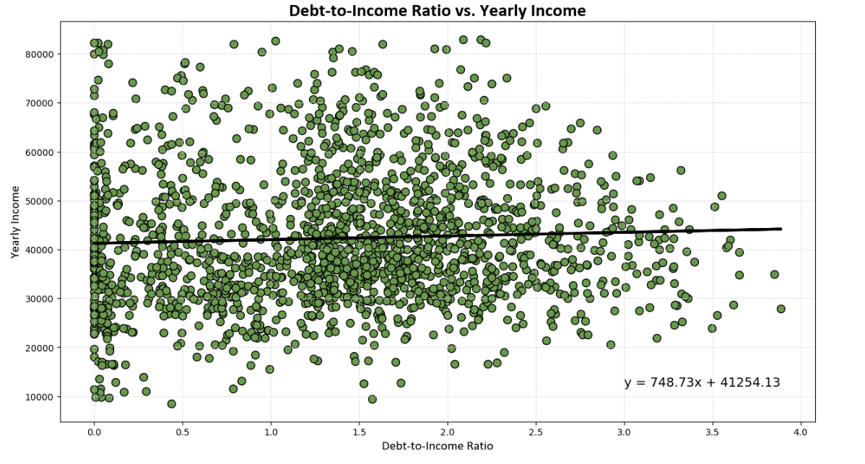

Slide 19
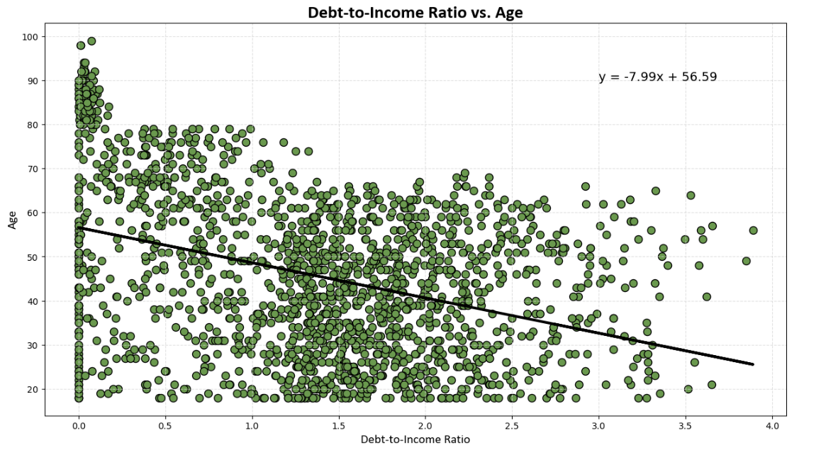

Slide 20
Conclusion|Final Thoughts
Debt-to-Income (DTI) ratio impact:
Credit Score
Yearly Income
Age
The only correlation that exists is between DTI and Age
As you mature in life your debt-to-income ratio lower, doesn’t matter income, credit score
Expected to see that the lower the income the higher the debt-to-ratio

Slide 21
Thank You!

